Slide 1


Slide 2


DIGITAL MARKETING ANALYSIS
Presented by:
Adarsh

Slide 3

CONTENT
1
Introduction
6
Modeling
2
Business Context
7
Evaluation
3
Data Overview
8
Results
5
Process Steps
9
Recommendation
10
Conclusion

Slide 4

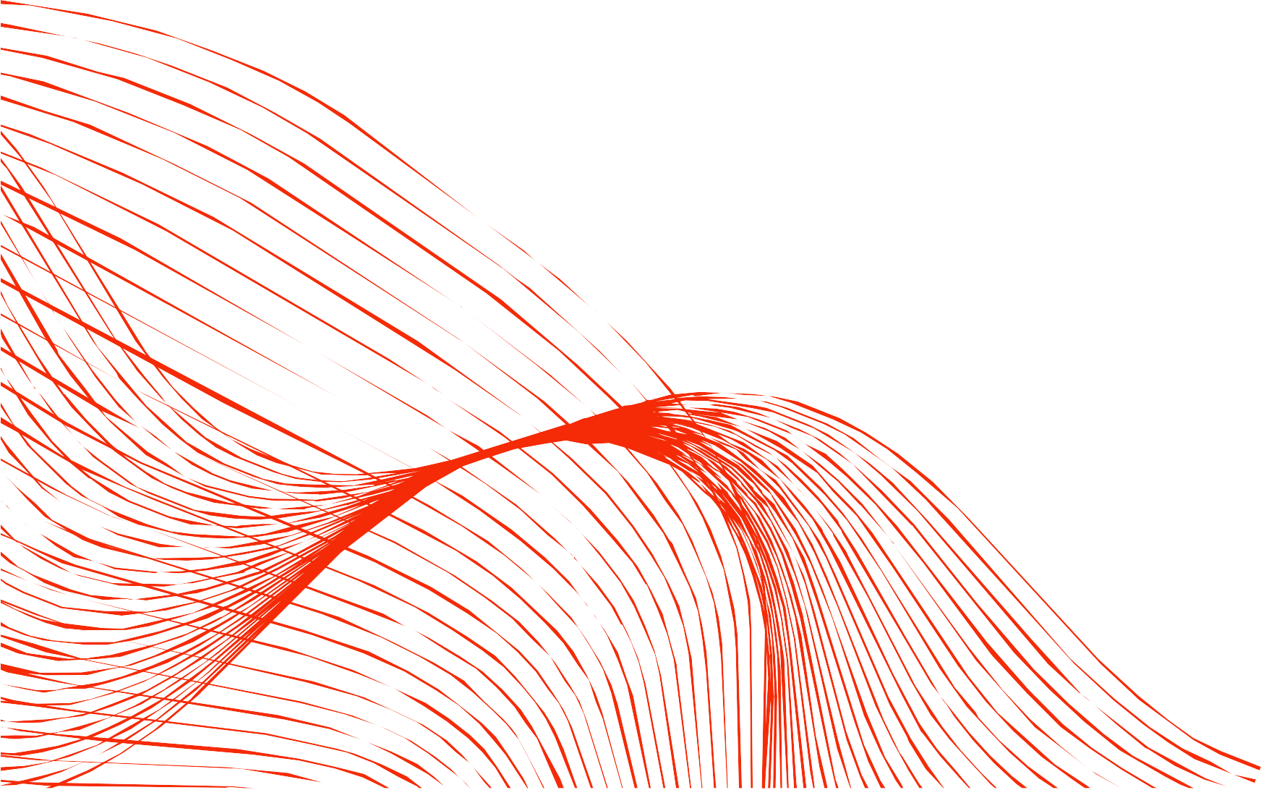
INRODUCTION
This analysis aims to offer marketing guidance and insights to a company based on demographics, customer engagement with marketing materials, and historical purchasing behavior.
In the competitive landscape of e-commerce, achieving high conversion rates is crucial for driving sales and maximizing revenue.

Slide 5

BUSINESS CONTEXT
An e-commerce company is looking to enhance the effectiveness
of its digital marketing campaigns. Despite having a significant reach and engagement, the company is not achieving its desired conversion rates, which impacts overall sales and revenue. The company wants to understand the factors that influence customer conversions, such as demographics, customer engagement with marketing materials, and historical purchasing behavior.

Slide 6





DATA OVERVIEW
The dataset contains 8,000 records and 20 columns, capturing customer, campaign, and engagement details from a digital marketing campaign.
It includes a mix of numerical (10 columns), categorical (5 columns), and floating-point (5 columns) features — allowing for both statistical and behavioral analysis.
The data is clean, with no missing values or duplicate entries, ensuring reliability for analytics and modeling.

Slide 7
DATA
OVERVIEW
Demographics: Age, Gender, Income — define customer profile
.
Campaign Info: Channel and Type show ad placement.
Performance: AdSpend, CTR, ConversionRate track success.
Engagement: Website Visits reflects audience activity.

Slide 8


PROCESS STEPS
DATA CLEANING
Checking for missing values. Checking for duplicates.
Drop irrelevant columns. Feature selection

Slide 9

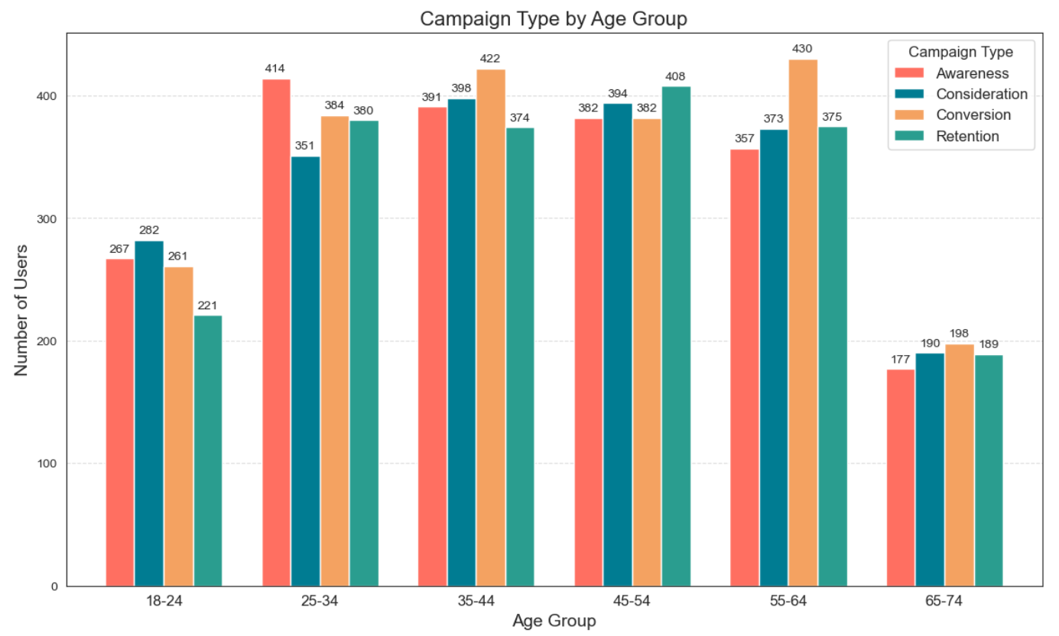
EXPLORATORY DATA ANALYSIS
ANALYZING AGE AND CAMPAIGN TYPE
Balanced Reach: All campaign types are evenly distributed across age groups, showing consistent marketing efforts.
Young Audience (18–24): Lower engagement, highest in Consideration campaigns — likely due to limited interest or spending power.
Prime Age (25–44): Strongest response — 25–34 excel in Awareness, while 35–44 lead in Conversion campaigns.
Mature Audience (45–64): Higher focus on Retention and Conversion, reflecting loyal and decisive customers.

Slide 10
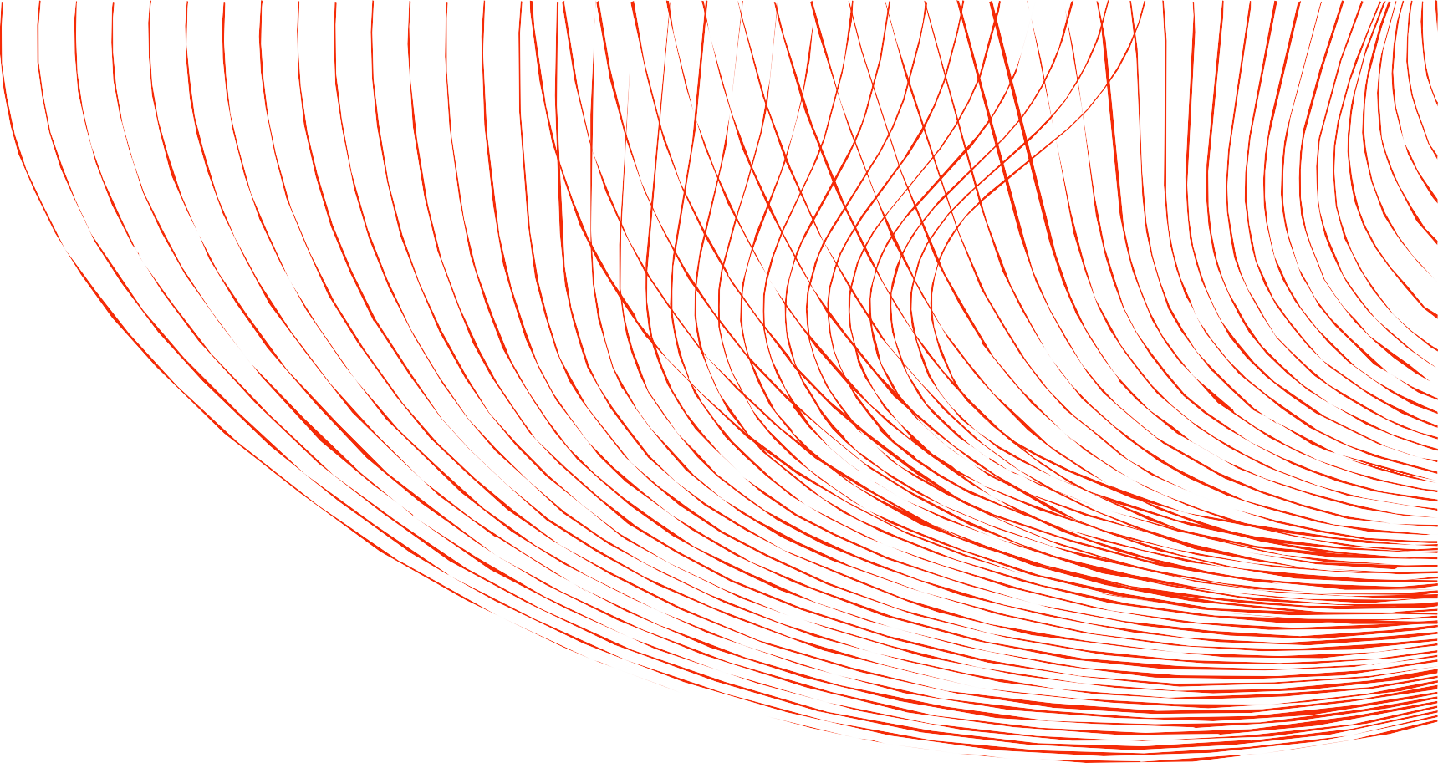
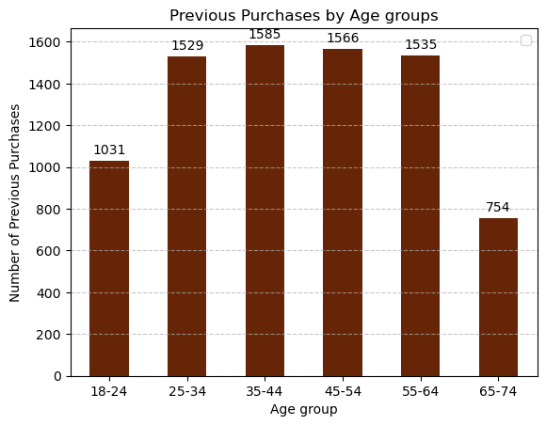
ANALYZING AGE AND PREVIOUS PURCHASES
18-24: seem to have a less previous purchases which maybe attributed to less purchasing power (1031).
34-44: Have the highest previous purchases count (1585).
25-34, 45-64 and 55-64 : have high previous purchases (above 1500)
65-74: This group has lowest previous purchases which maybe attributed by less engagement.

Slide 11
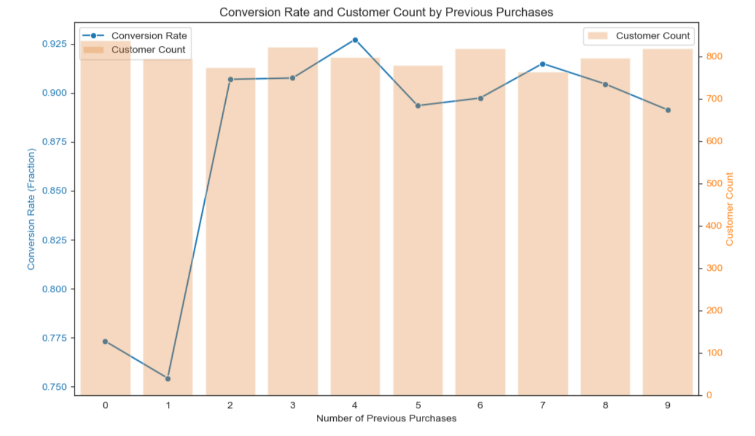
ANALYZE Conversion Rate and Customer by Previous Purchases
The individuals with more previous purchases seems to result in a higher conversion

Slide 12


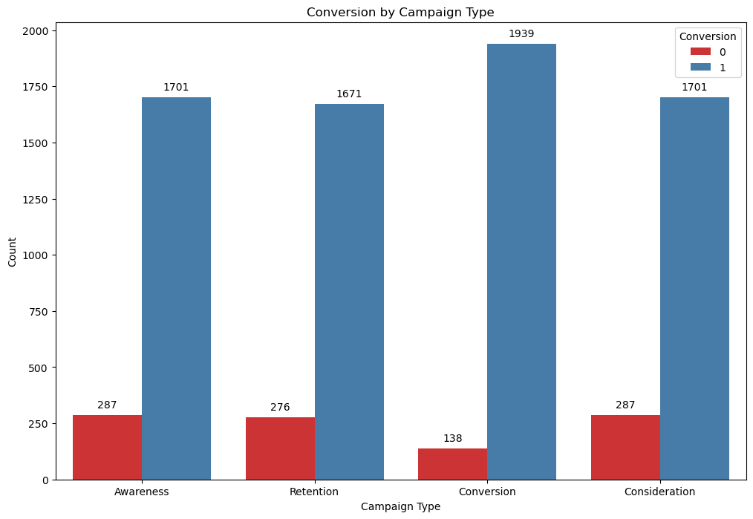
ANALYZING CONVERSION ON CAMPAIGN TYPE
'Conversion' campaign type has the highest conversion (1913)

Slide 13
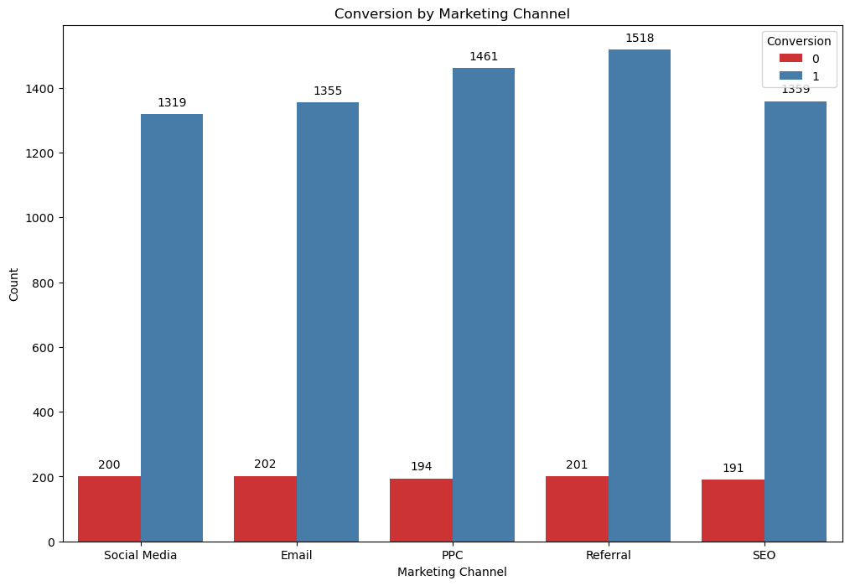
ANALYZING CONVERSION ON MARKETING CHANNEL
'Referral' leads the marketing channels on conversion with (1518)

Slide 14

MODELING
MODEL EVALUATION
Overall Accuracy Precision and recall
PREPROCESSING
Data cleaning, Scaling data, Pipelines
Import data and EDA
5
1
3
4
2
MODELING
Logistic Regression, Decision tree, Xgboost
TRAIN-TEST SPLIT

Slide 15
MODEL EVALUATION
MODEL PERFORMANCE
Model
Class
Precision
Recall
F1 Score
Logistic Regression
Class 0
0.22
0.52
0.30
0.92
73
Class 1
0.81
Decision Tree
0.33
0.46
Class 0
0.38
0.92
0.87
Class 1
0.89
XGBClassifier
Class 0
0.80
0.42
0.58
Class 1
0.92
0.99
0.96

Slide 16

MODEL EVALUATION
FINAL MODEL
Model
Class |  | Precision |  | Recall |  | F1 Score
Class 0 |  | 0.80 |  | 0.42 |  | 0.58
Class 1 |  | 0.92 |  | 0.99 |  | 0.96
XGBClassifier

Slide 17

MODEL EVALUATION
KEY RESULTS:
Logistic Regression: Iterative improvements using SMOTE and feature selection.
Decision Tree: The model showed signs of overfitting; iterative improvements did not fully resolve this.
XGBoost: Demonstrated strong performance with the ability to handle complex relationships in the data.

Slide 18

RECOMMENDATION
Given the model’s strong performance, i recommend proceeding with deploying the XGBoost model with the following considerations:
Focus on High-Impact Features: Prioritize variables like AdSpend, CTR, and ConversionRate for targeted campaign improvement.
Optimize Marketing Channels: Invest more in top-performing channels identified by the model (e.g., those driving higher conversions)
Enhance Data Quality: Continuously clean and update data to improve model reliability and decision accuracy.
Implement Predictive Insights: Use the model’s predictions to personalize offers and increase customer retention.

Slide 19
CONCLUSION
Relevant Findings:
Demographic Targeting: Different age groups respond differently to various campaign types.
Campaign Efficiency: Referrals and Conversion campaigns are the most effective channels.
Retention Strategy: Higher loyalty points and previous purchases lead to higher conversion rates.
XGBoost model performed best, delivering the most accurate and reliable predictions.
Findings highlight the importance of targeted marketing and data-driven decision-making.
Overall, the project demonstrates how machine learning enhances marketing efficiency and ROI.

Slide 20
NEXT STEPS
Prepare for Deployment: Integrate the XGBoost model into the existing production pipeline. Ensure that the necessary infrastructure is in place for real- time or batch processing, depending on the business needs.
Continuous Data Collection: As new data is collected, ensure it is correctly labeled and stored. This data will be vital for monitoring the model's performance and retraining.

Slide 21


THANK YOU !
Email
adarshreddy838@gmail.com
LinkedIn
Adarsh

